Slide 1
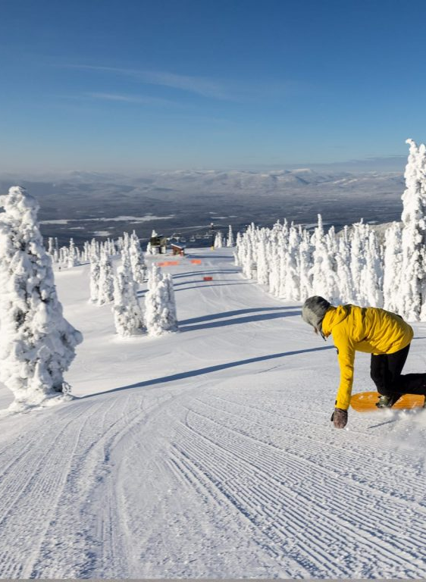
Big Mountain Resort Optimizing Ticket Pricing and Facility Investments
Harry Pachchala

Slide 2
Problem Identification
Overview: Big Mountain Resort’s current pricing strategy (premium above market average) may not be leveraging its facilities optimally.
Challenge: Operating costs have increased by $1.54M with the new chairlift installation, necessitating an evaluation of ticket pricing and facility investments to maximize revenue.
Goal: Develop a data-driven pricing model and provide actionable investment recommendations.

Slide 3
Key Findings and Recommendations
Key Insights:
Skiable terrain and vertical drop are the most significant price drivers.
Montana’s ticket prices are lower than comparable markets like Colorado and Utah.
Recommendations:
Gradually increase ticket prices from $81 to $83 to recover chairlift costs.
Introduce a weekend premium to capitalize on peak demand.
Prioritize investments in skiable terrain and vertical drop enhancements while evaluating cost-cutting for underperforming features like night skiing.

Slide 4
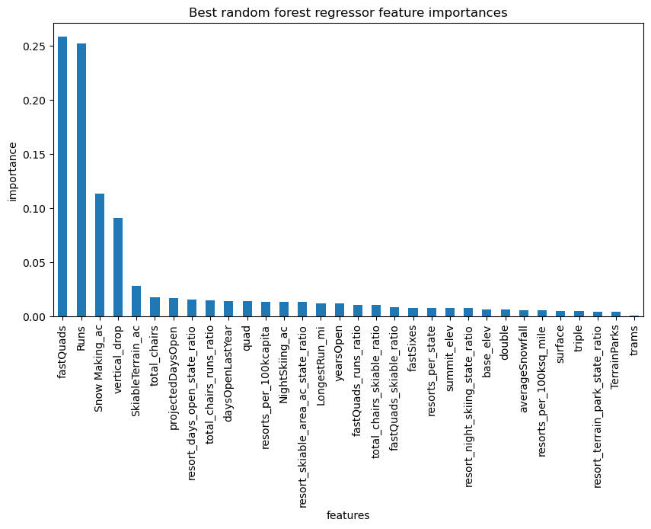
Modeling Results: Feature Importance
Implications: These factors justify higher ticket prices due to their strong impact on visitor experience and pricing potential.
Visualization: Feature importance plot

Slide 5
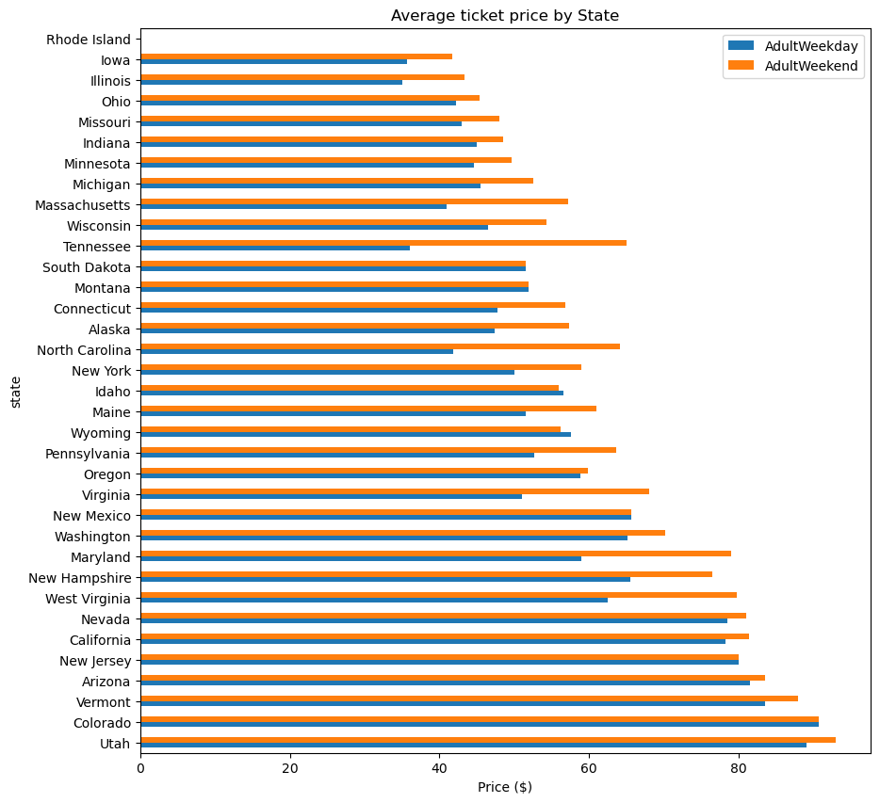
Market Comparison
Insight: Montana’s average ticket price leaves room for a competitive increase without risking visitor loss.
Visualization: Bar chart of average ticket prices across states

Slide 6
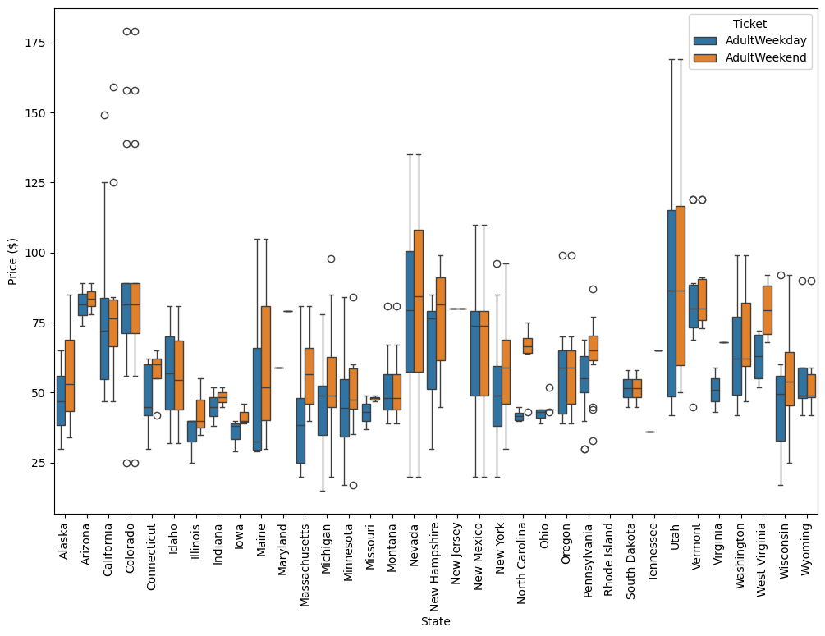
Revenue Optimization: Weekday vs. Weekend Pricing
Recommendation: Implement a differentiated pricing strategy to increase revenue during high-demand weekends.
Visualization: Boxplot of weekday vs. weekend ticket prices across resorts.

Slide 7
Summary and Conclusion
Summary:
Increase ticket price to $83 and consider a weekend premium.
Focus investments on high-impact facilities.
Evaluate cost-saving opportunities for low-impact features.
Next Steps: Monitor the impact of pricing changes on revenue and visitor satisfaction. Conduct periodic market assessments to refine the strategy.

